Slide 1

Soquimich (SQM) – Empirical Finance & Valuation
Yann touret M2 Finance

Slide 2

Enterprise
25% of the lithium mining market and also do fertilizants (27% of sales)
20B usd company with competitors like albemarle,and the chinese tianqi
Contracts all over the world , with operations in australia, china and Chile
They are in the NYSE and are quoted in usd

Slide 3
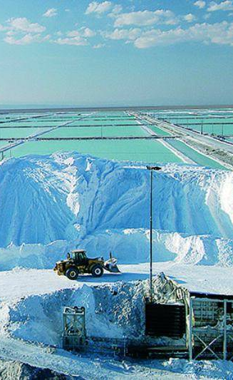
Objective of the research
What drives SQM returns? What is a reasonable value per share?
Market ( SP500)
Industry risks (ETF lithium LIT)
Lithium commodity prices

Slide 4
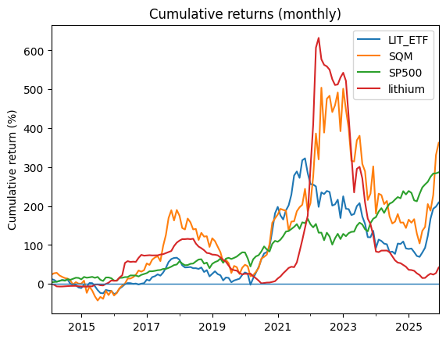
Data and sample
Sources from INSEE (commodity) and yahoo finance
Start in 2014 until end of 2025
Monthly data

Slide 5
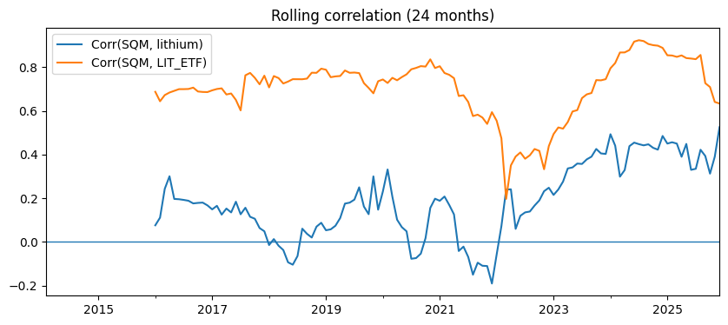
correlations
Tried to find a correlation between the stock price and lithium price
The higher was the present one (0,26) but I tried also a lag or a lead of 3 and 6 months
To see if it was explained by Expectations or past prices.

Slide 6
models
CAPM-only to see the R2 with the SP500 and it was low (11%) and had a signifcant Beta of 1,04
Then 3 factor Model and i reach a R2 of 47%, which makes sense if we consider that it has 73% of his sales in lithium
The other % should be the risks that comes from being part of a not-stable country like Chile…

Slide 7
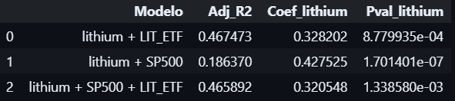
OLS ( 3 factor vs 2 factor)
As you can see the best model was the 2 factor one , which explains +- half of the returns.

Slide 8
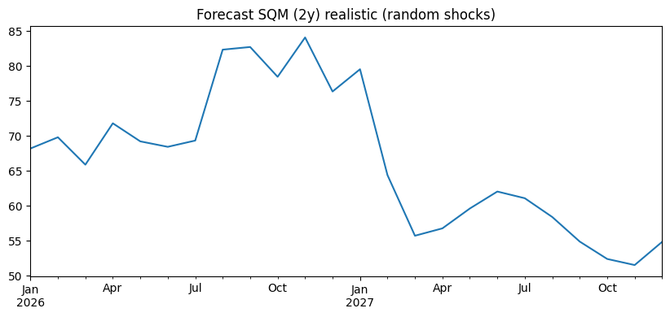
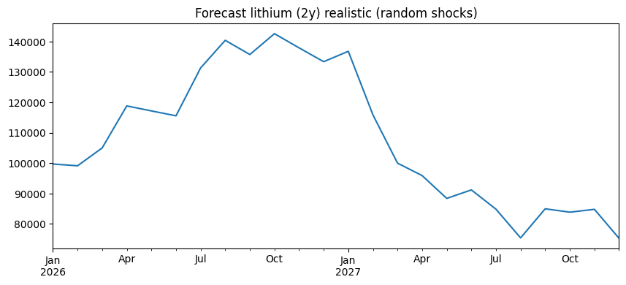
Forecasts (montecarlo)

Slide 9
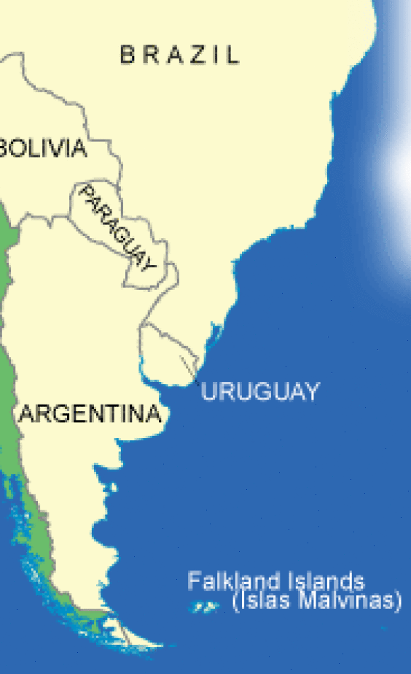
Valuation methods ( DCF and gordon-shapiro)
Then we compare it to the intrinsic value of the company itself.
We assumed a RF= 4% (Chilean bonds)
G=2% (Chilean %growth PIB)
I used an estimate (factset) of the FCFF from 2025 , because the numbers hasnt come out yet

Slide 10
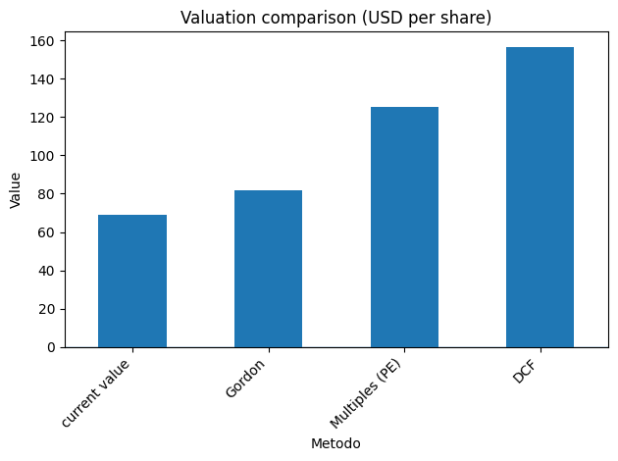
Conclusion
It has potential in the long term , specially if the lithium prices keep climbing or stable
They are biased , because the dividends are low (DDM), and the wacc with the EV/SALES are this year higher than average

